Slide 1
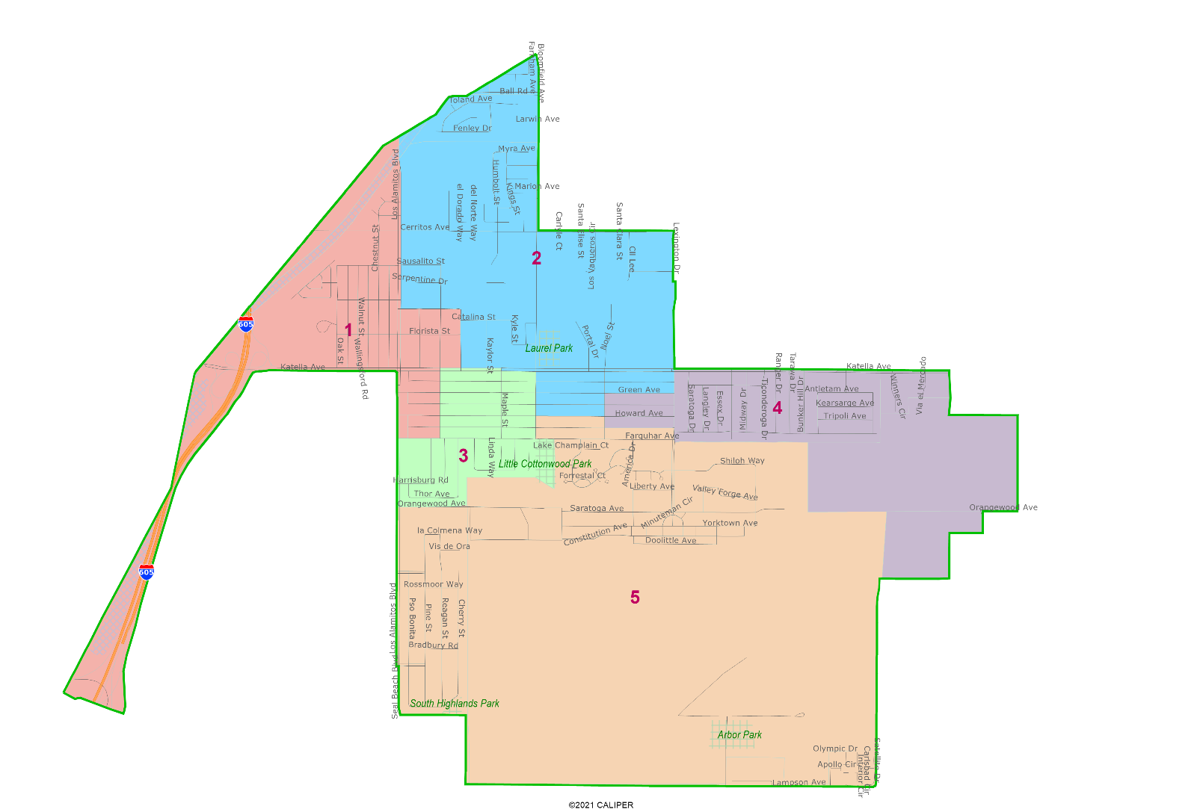
City of Los Alamitos
Introduction to Redistricting
Dr. Justin Levitt, Vice President
National Demographics Corporation

Slide 2
Redistricting – Why Now?
Los Alamitos moved to districts in 2018 and used districts for first time in 2020
Redistricting is required when the decennial Census data is released, once every ten years
Delays in receiving the Census data have delayed states, counties, cities, and other jurisdictions throughout California and the US
New laws like the Fair Maps Act have changed how districts are drawn and how the process is conducted

Slide 3
Redistricting Process & Schedule
Step | Description
Two Initial Hearings 1/18 & 2/7 | Held prior to release of draft maps. Education and to solicit input on the communities in the Districts.
Deadline for Submission 2/21/22 | Deadline for maps available for discussion at the February 28th Hearing
Two Draft Map Hearings 2/28 & 3/7 | Two Public Hearings to discuss and revise the draft maps
Deadline for Submission 3/11/2022 | Deadline for maps available for discussion at the March 21st Hearing
Final Adoption 3/21/2022 | Final selection and adoption of a map at a regular Council meeting
Map Adoption By April 17, 2022 | Final map must be posted at least 7 days prior to adoption. Map adopted via ordinance or resolution.

Slide 4

Redistricting Rules and Goals
1. Federal Laws
2. California Criteria for
Cities
3. Other Traditional Redistricting Principles
Equal Population
Federal Voting Rights Act
No Racial Gerrymandering
Geographically contiguous
Undivided neighborhoods and “communities of interest”
(Socio-economic geographic areas that should be kept together)
Easily identifiable boundaries
Compact
(Do not bypass one group of people to get to a more distant group of people)
Prohibited: “Shall not favor or discriminate against a political party.”
Minimize voters shifted to different election years
Respect voters’ choices / continuity in office
Future population growth
Preserving the core of existing districts

Slide 5

Defining Neighborhoods
1st Question: What is your neighborhood?
2nd Question: What are its geographic boundaries?
Examples of physical features defining a neighborhood boundary:
Natural neighborhood dividing lines, such as highway or major roads, rivers, canals and/or hills
Areas around parks or schools
Other neighborhood landmarks
In the absence of public testimony, planning records and other similar documents may provide definition.

Slide 6
Beyond Neighborhoods:
Defining Communities of Interest
1st Question: What defines your community?
Geographic Area, plus
Shared issue or characteristic
  Shared social or economic interest
  Impacted by county policies
Tell us “your community’s story”
2nd Question: Would this community benefit from being “included within a single district for purposes of its effective and fair representation”?
Or would it benefit more from having multiple representatives?
Definitions of Communities of Interest may not include relationships with political parties, incumbents, or political candidates.

Slide 7

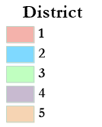
Current Districts
Total Deviation = 21.5%

Slide 8
Demographic Summary of Existing Districts
Estimates using official 2020 State-Adjusted Census Data
Each of the 5 districts must contain about 2,359 people.

Slide 9
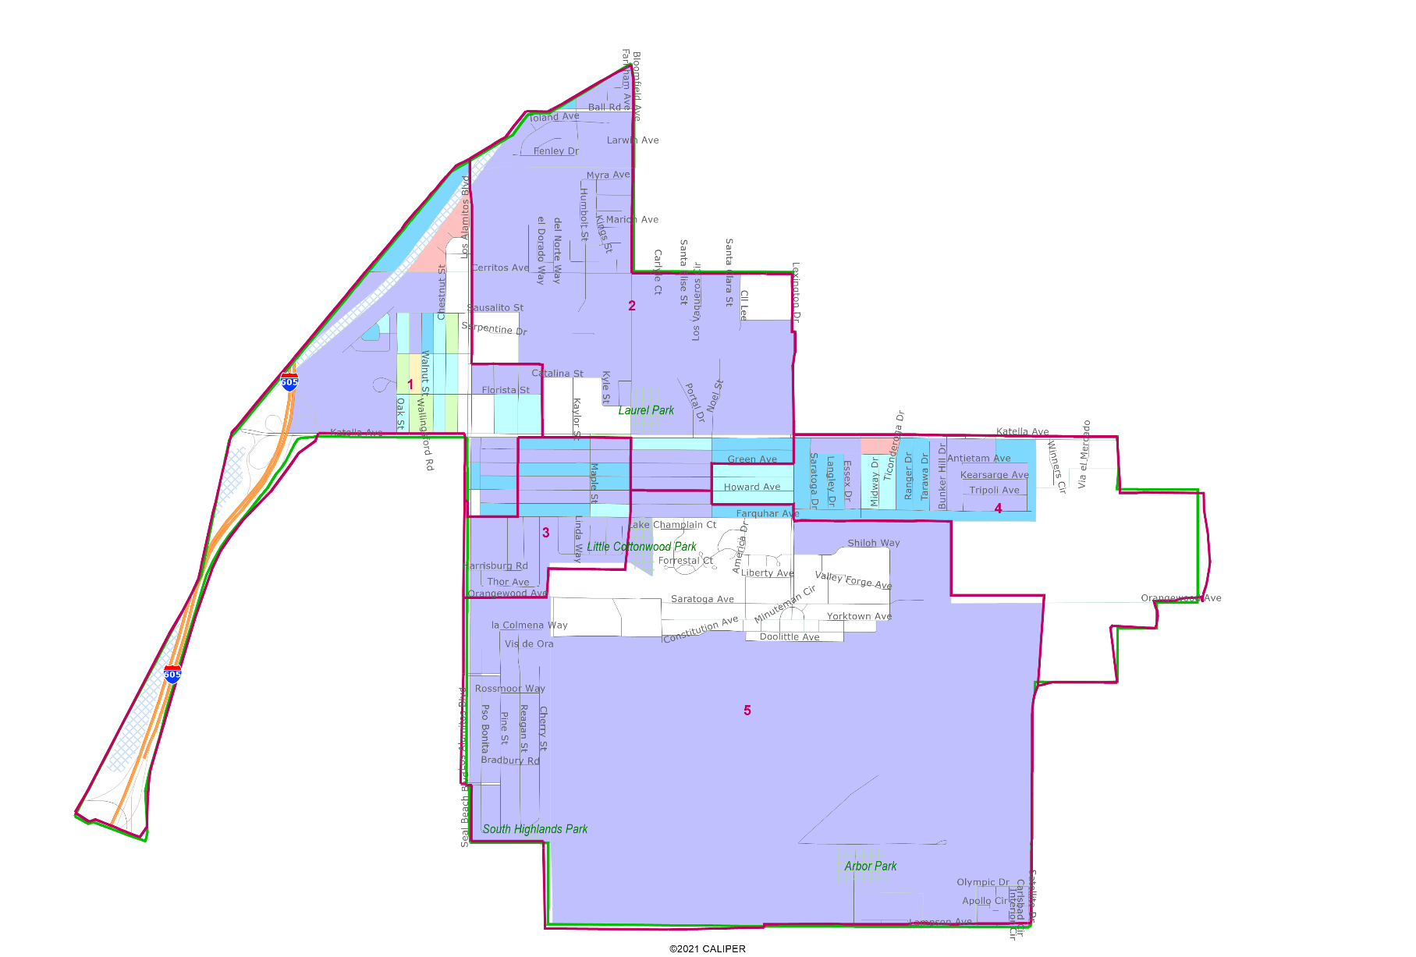
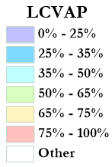
Latino CVAP
Latins are concentrated in Old Town West, particularly west of Los Alamitos Blvd.

Slide 10
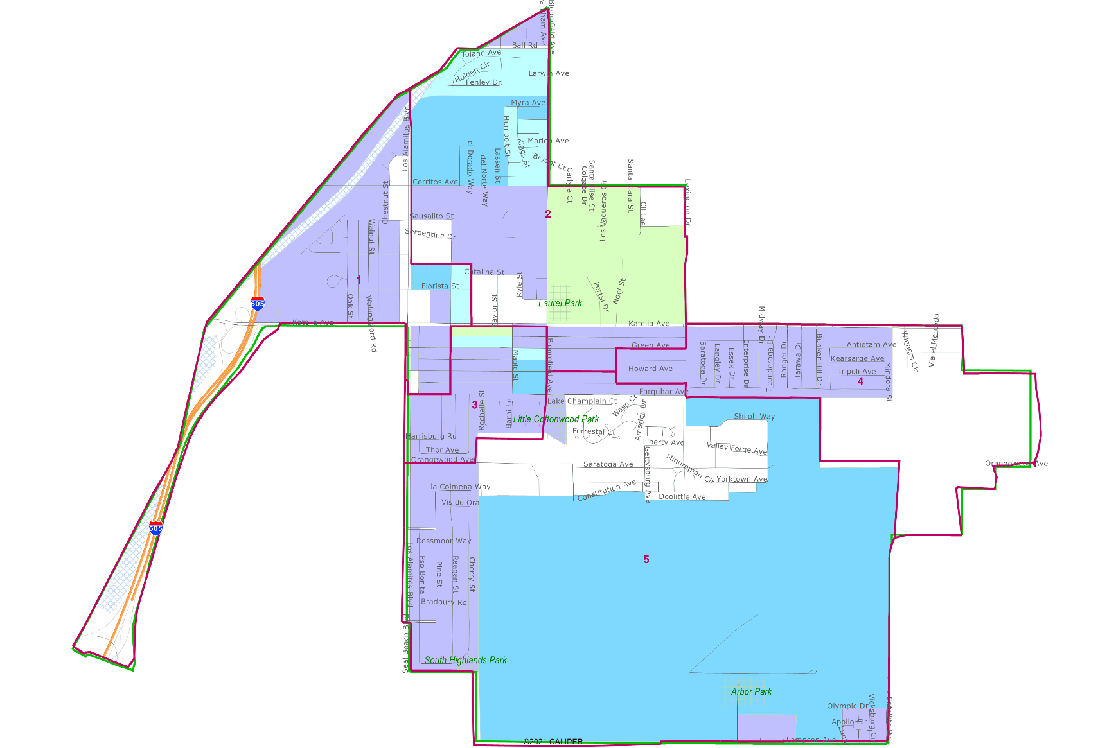

Asian CVAP
Asian neighborhoods are found particularly in the northern portion of the city, particularly north of Cerritos Ave and east of Los Alamitos Blvd.

Slide 11
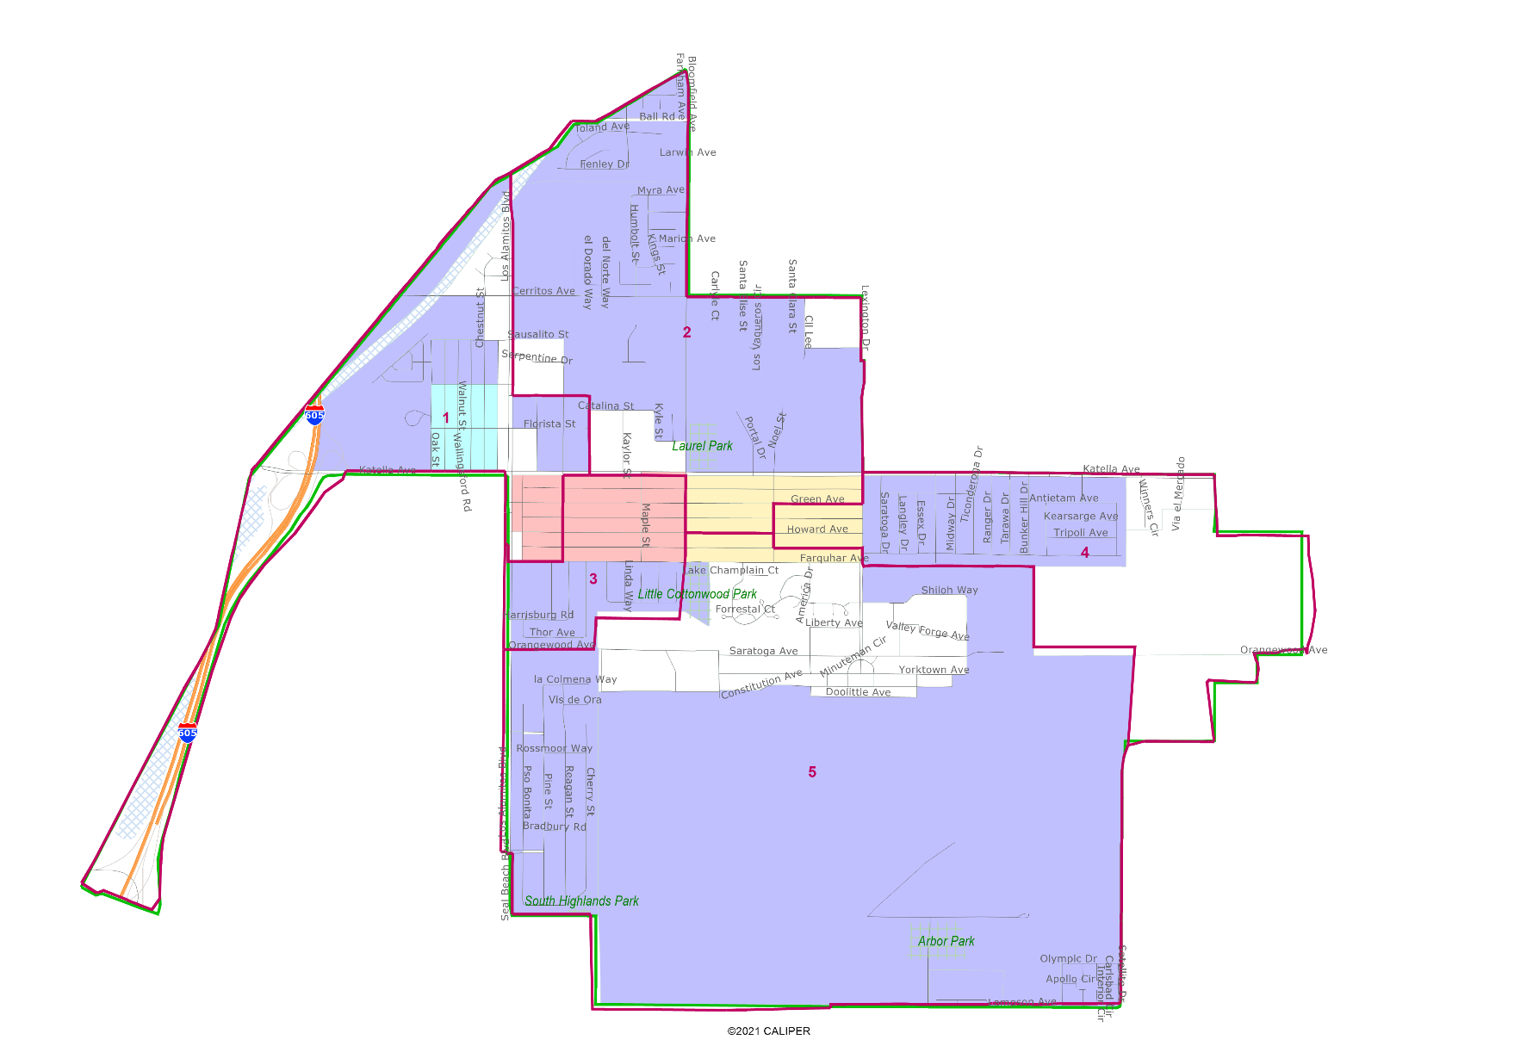
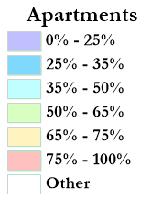
Apartments & Multifamily Housing
Other socio-economic measures are available

Slide 12
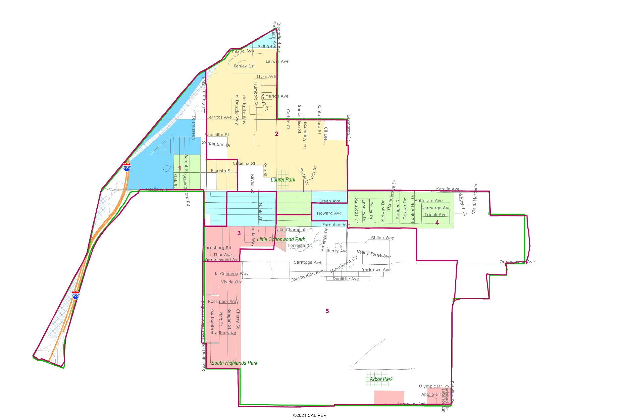
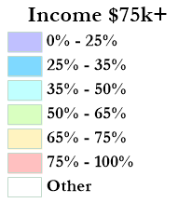
Income over $75k
Other socio-economic measures are available

Slide 13
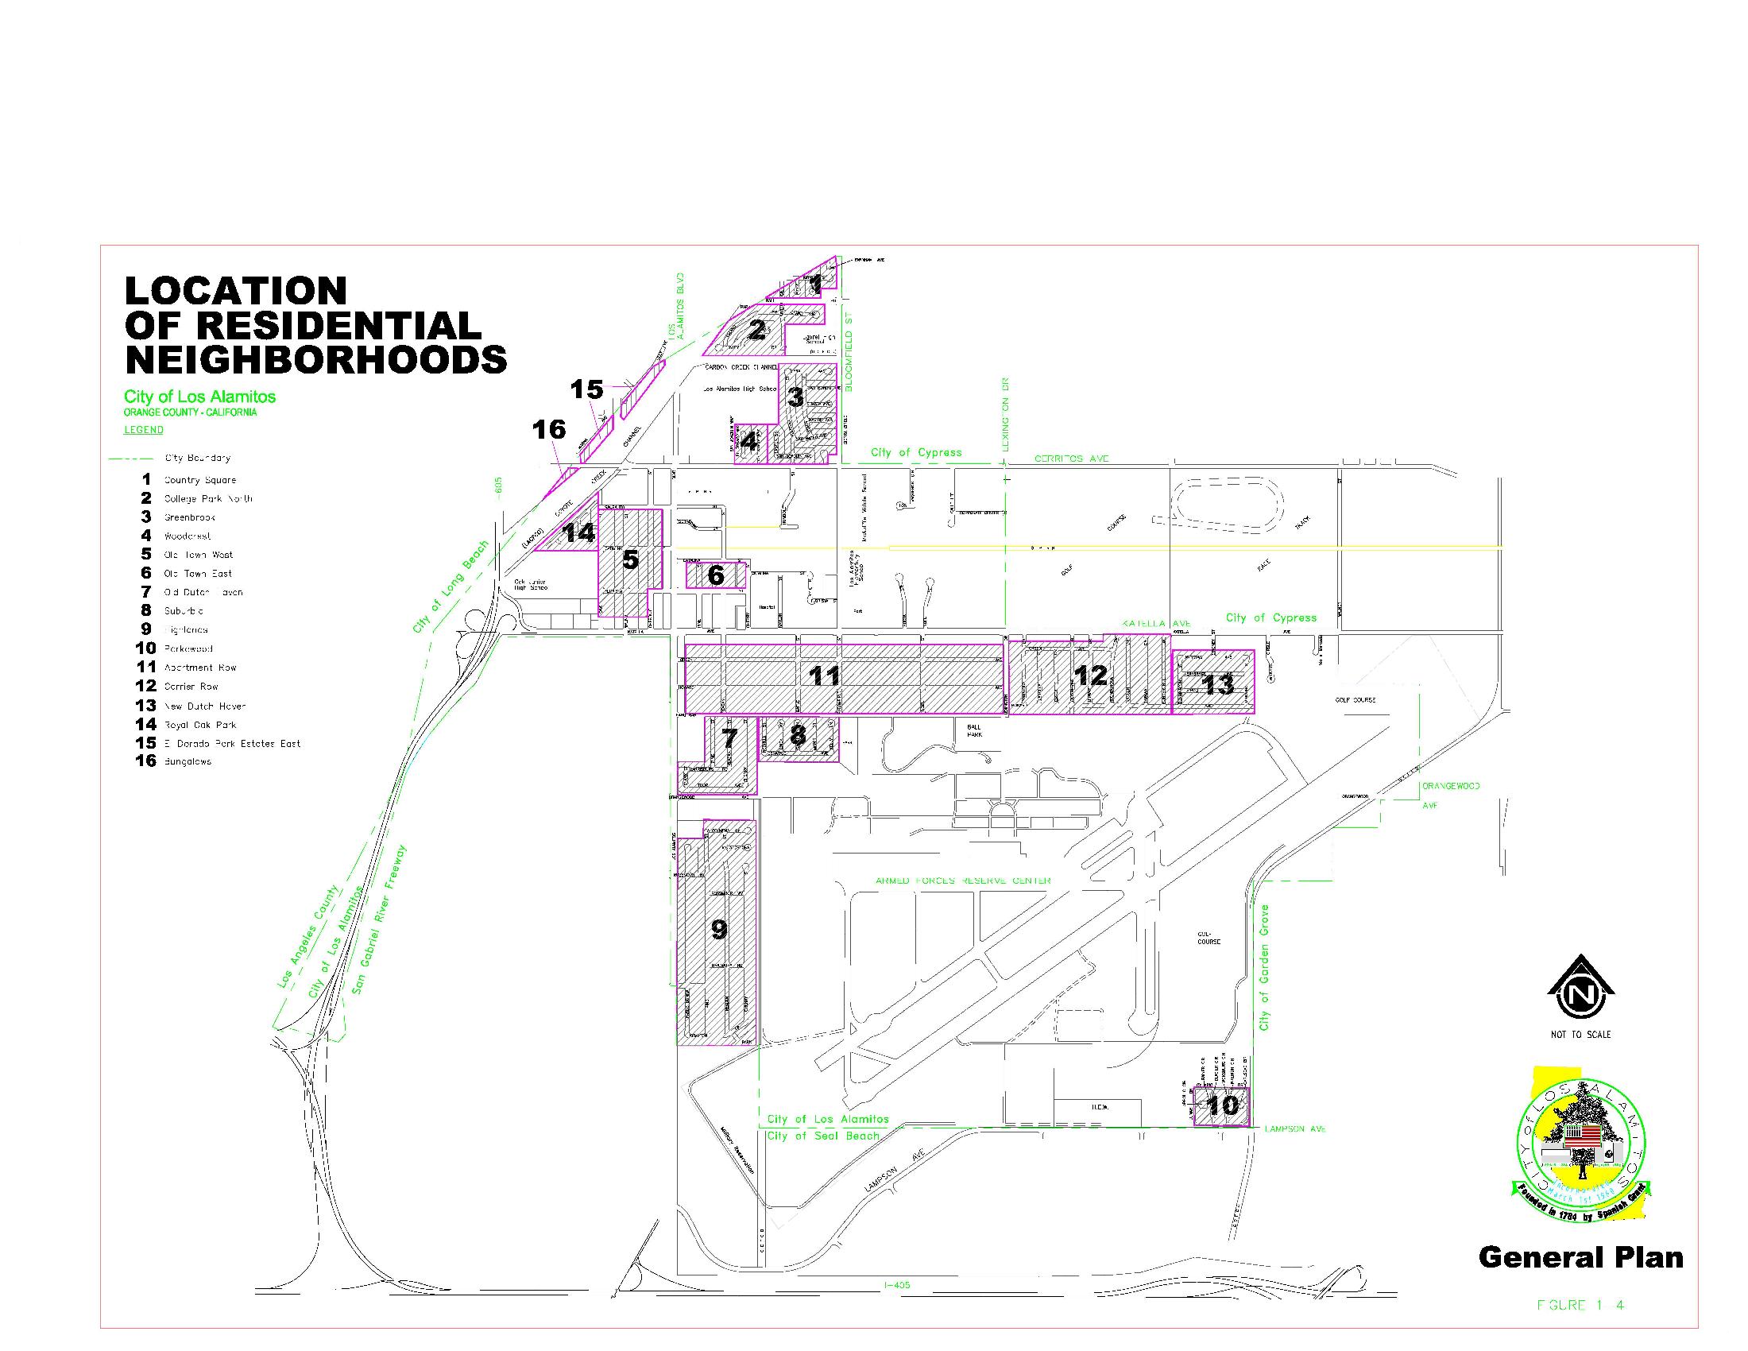
Neighborhood Map

Slide 14
Public Mapping and Map Review Tools
Different tools for different purposes
Different tools for different levels of technical skill and interest
  Simple “review draft maps” tool
  Easy-to-use “Draw your neighborhood” tool
  Paper- and Excel-based simple “Draw a draft map” tools
  Powerful, data-rich “Draw a draft map” tool
Whether you use the powerful (but complicated) online mapping tool, Excel, the paper kit, or just draw on a napkin, we welcome your maps!

Slide 15
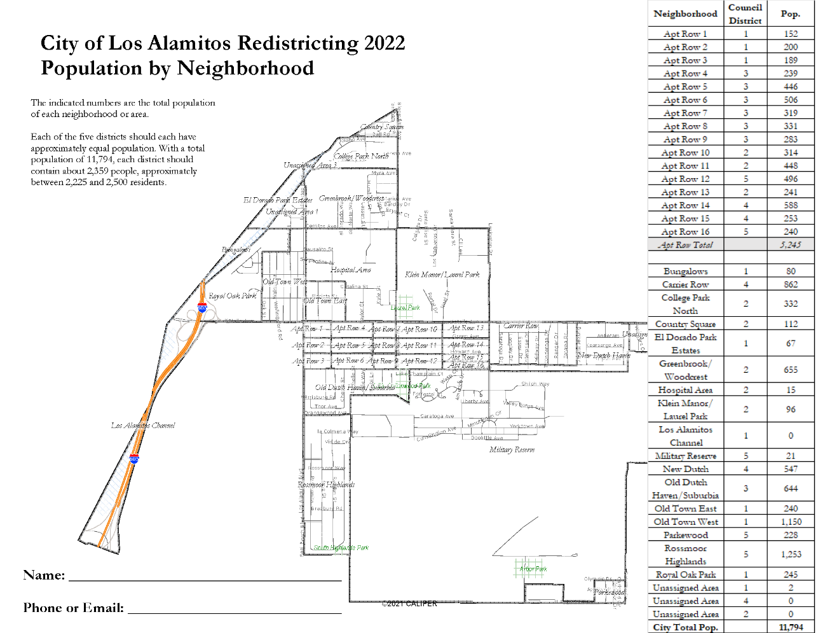
Simple Map Drawing Tool
Paper “Public Participation Kit”
For those without internet access or who prefer paper
Total Population Counts only – no demographic numbers

Slide 16
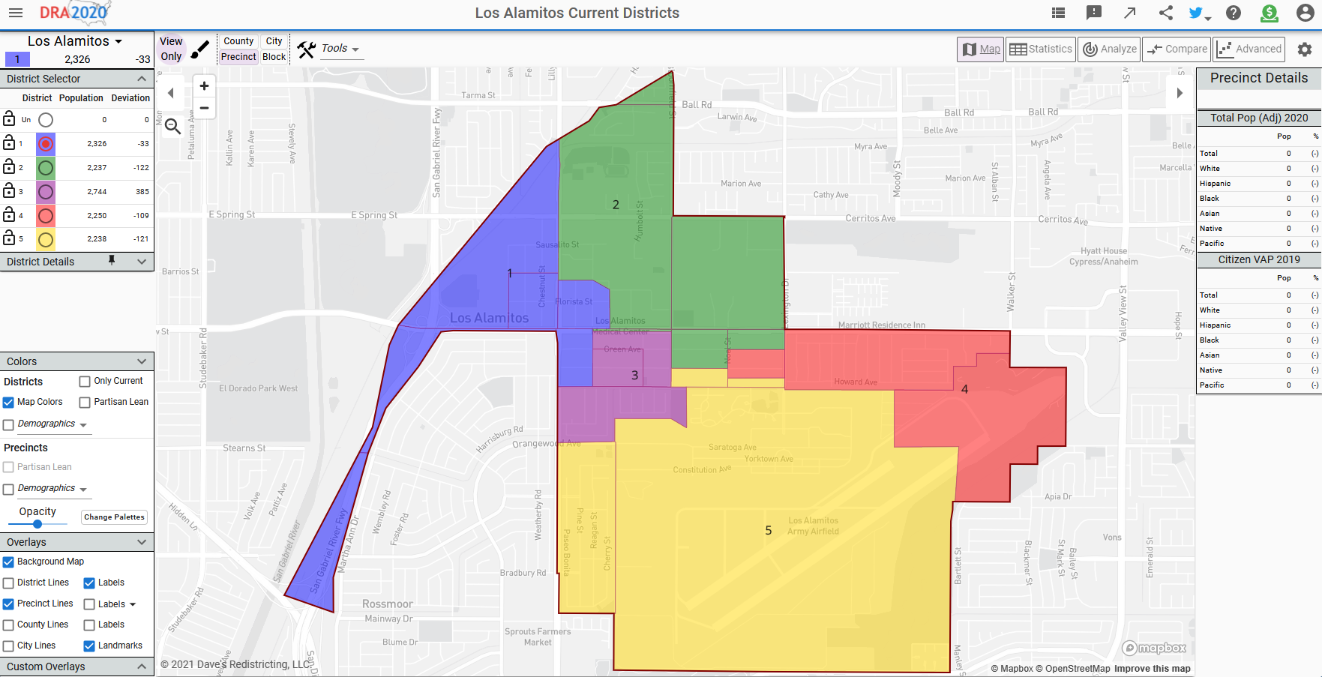
Dave’s Redistricting App (DRA)
“Draw Your Community of Interest” focus
Also includes simple district-mapping tool
Only available in English
Email a link to your map to the City and publish or share

Slide 17
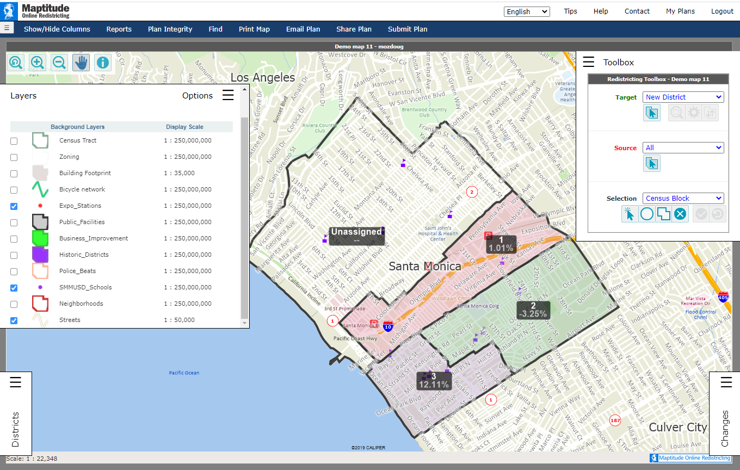
Caliper’s “Maptitude Online Redistricting”
Full Database, Powerful Online Mapping Tool
Powerful, common, data-rich online tool
Six language options: English, Spanish, Portuguese, Vietnamese, Mandarin and Korean
Quick Start Guide

Slide 18

Hearing & Discussion
What is your neighborhood and what are its boundaries?
What other notable areas are in the City, and what are their boundaries?
Any questions about the mapping tools?

