Slide 1
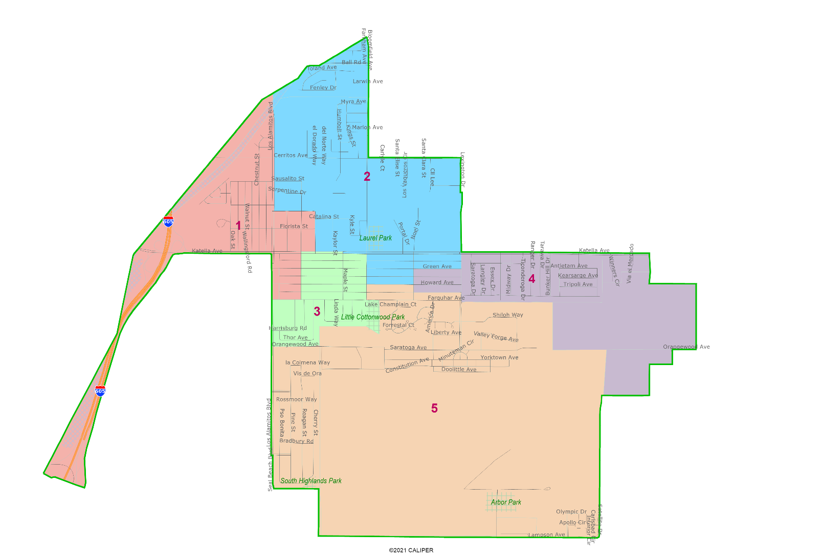
City of Los Alamitos
Draft Plan Presentation
Dr. Justin Levitt, Vice President
National Demographics Corporation

Slide 2
Redistricting Process & Schedule
Step | Description
Two Initial Hearings 1/18 & 2/7 | Held prior to release of draft maps. Education and to solicit input on the communities in the Districts.
Two Draft Map Hearings 2/28 & 3/7 | Two Public Hearings to discuss and revise the draft maps
Introduction of Ordinance 3/7/2022 | Final selection and adoption of a map at a regular Council meeting
Map Adoption By April 17, 2022 | Final map must be posted at least 7 days prior to adoption. Map adopted via ordinance or resolution.

Slide 3
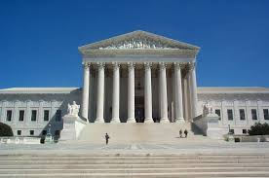
Redistricting Rules and Goals
1. Federal Laws
2. California Criteria for
Cities
3. Other Traditional Redistricting Principles
Equal Population
Federal Voting Rights Act
No Racial Gerrymandering
Geographically contiguous
Undivided neighborhoods and “communities of interest”
(Socio-economic geographic areas that should be kept together)
Easily identifiable boundaries
Compact
(Do not bypass one group of people to get to a more distant group of people)
Prohibited: “Shall not favor or discriminate against a political party.”
Minimize voters shifted to different election years
Respect voters’ choices / continuity in office
Future population growth
Preserving the core of existing districts

Slide 4
Draft Maps
All maps are also available on the Interactive Web Viewer

Slide 5
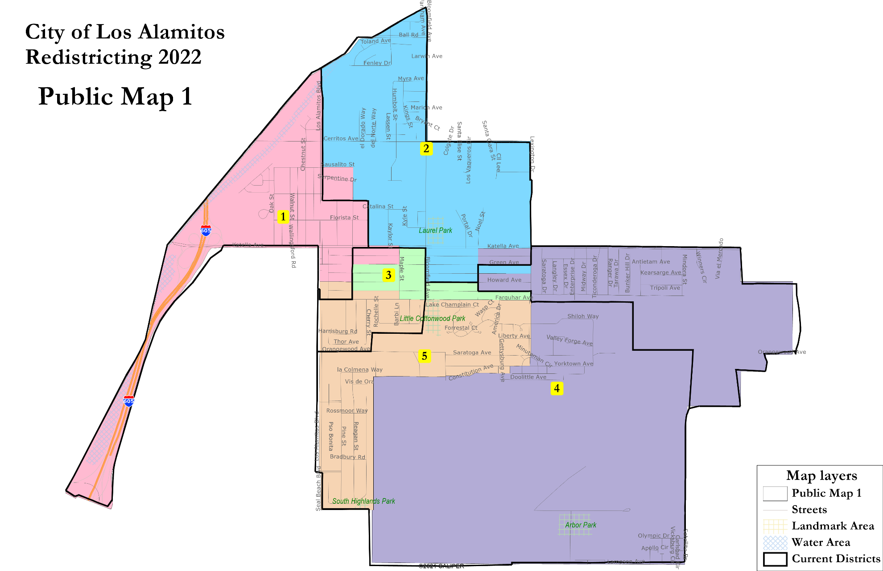
Public Map 1

Slide 6
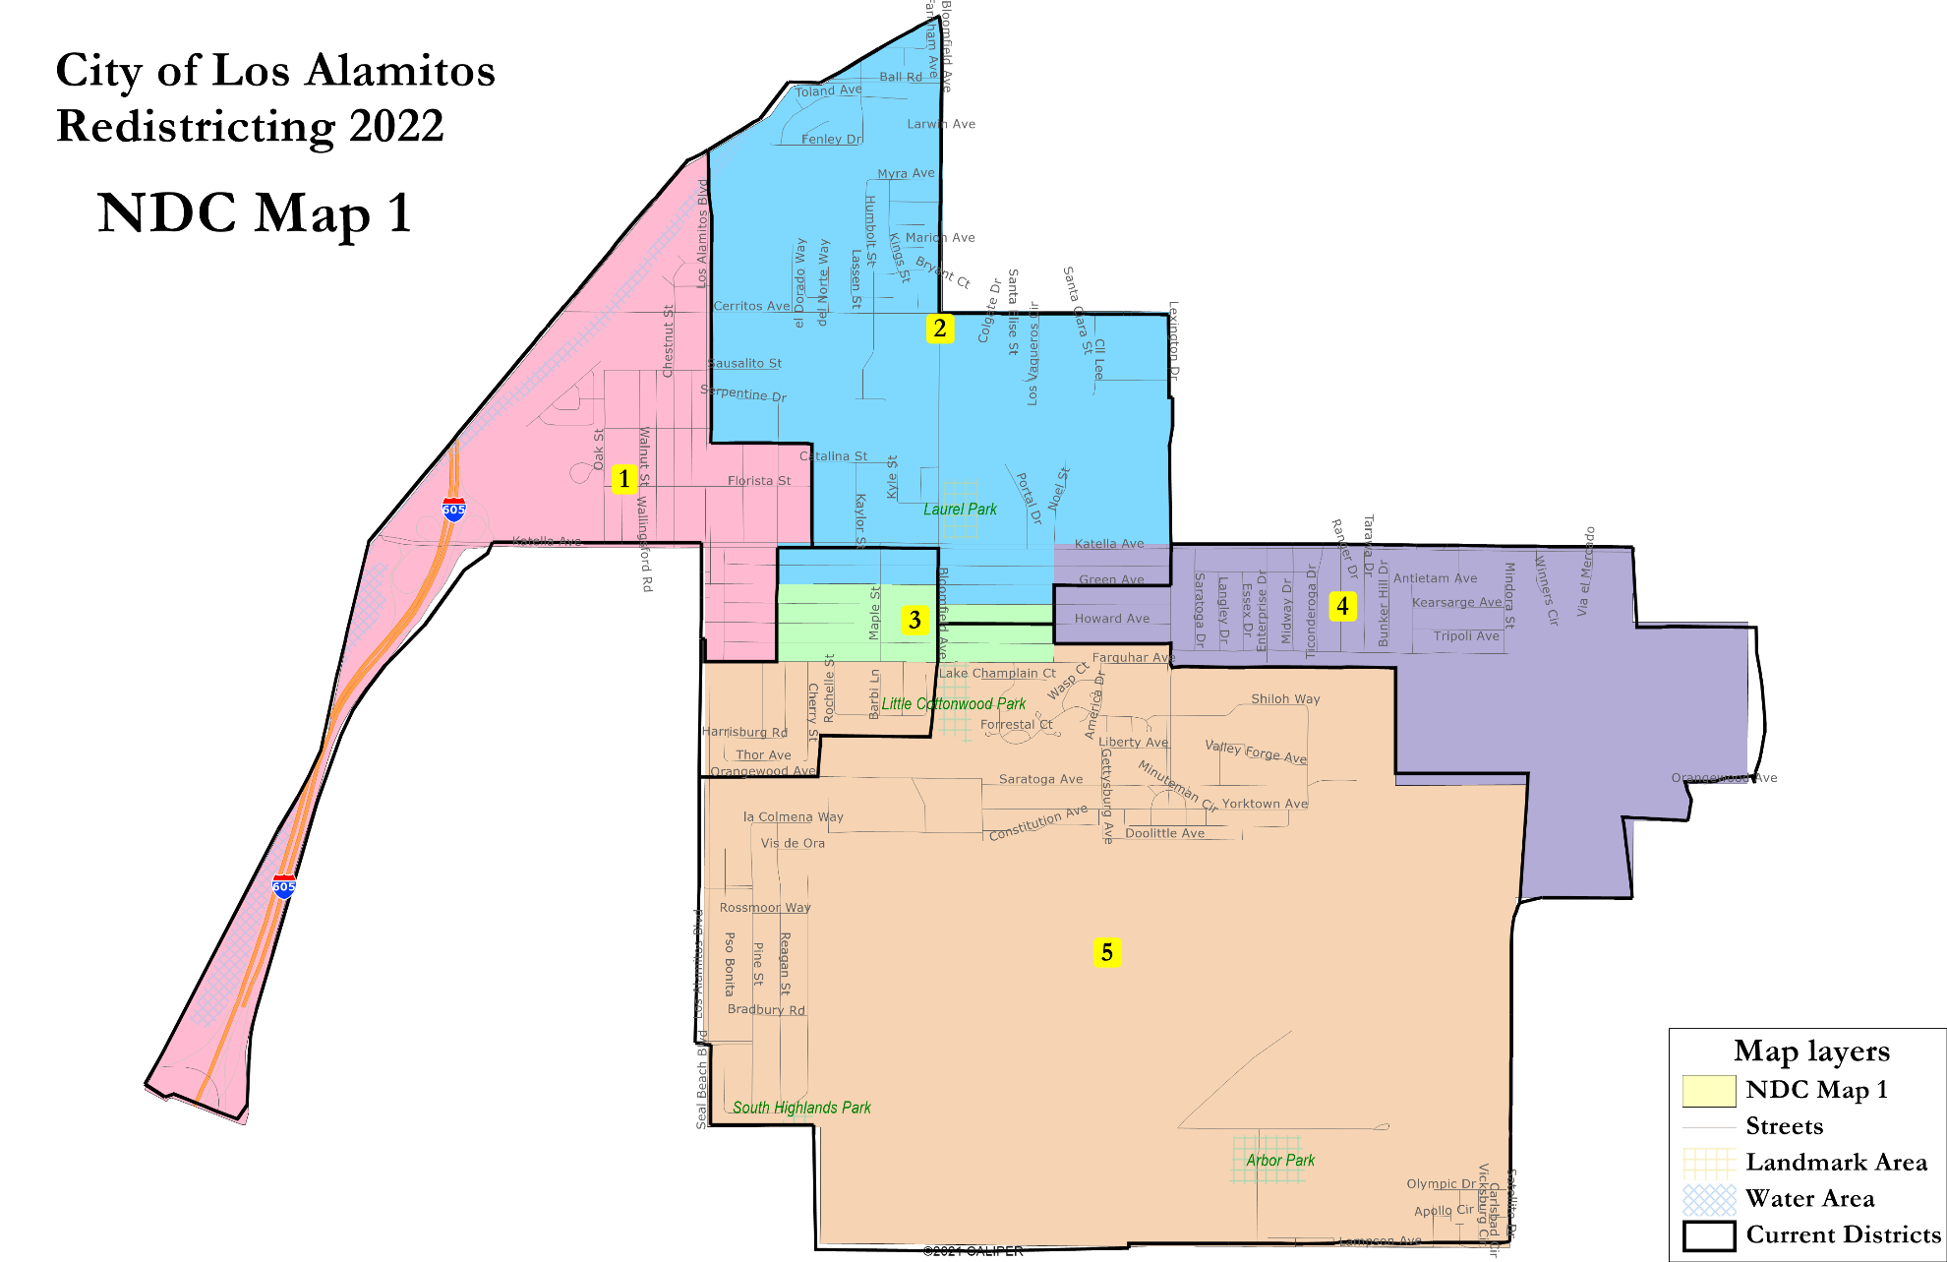
NDC Map 1

Slide 7
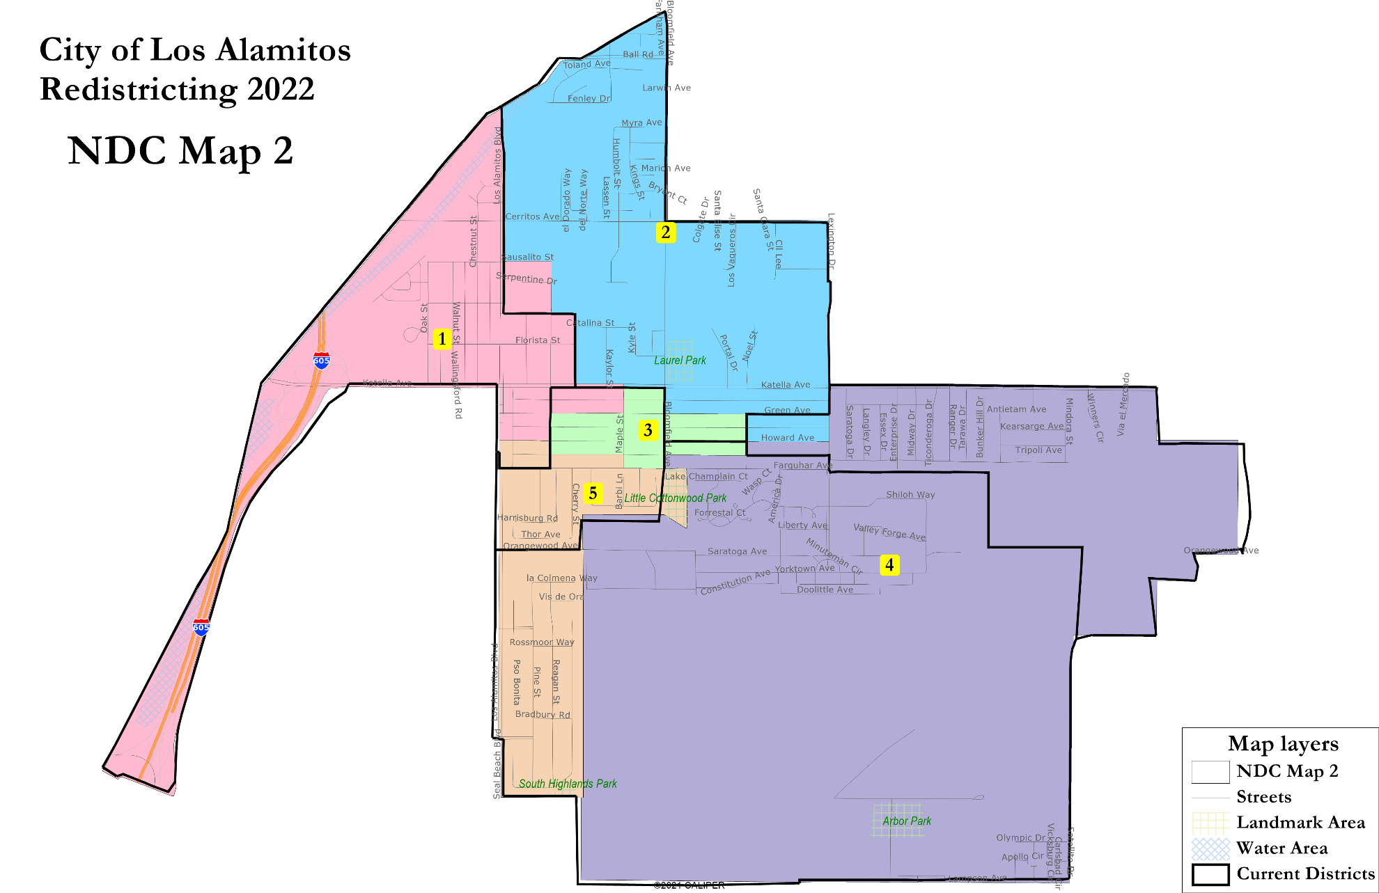
NDC Map 2

Slide 8

NDC Map 3

Slide 9

NDC Map 4

Slide 10
Public Hearing & Discussion
How well do the draft maps comply with the Fair Maps Act?
What do you like about (parts of) each map? What works in each option?
Council may eliminate maps, request additional maps or tests, and provide additional direction to the demographer

