Slide 1
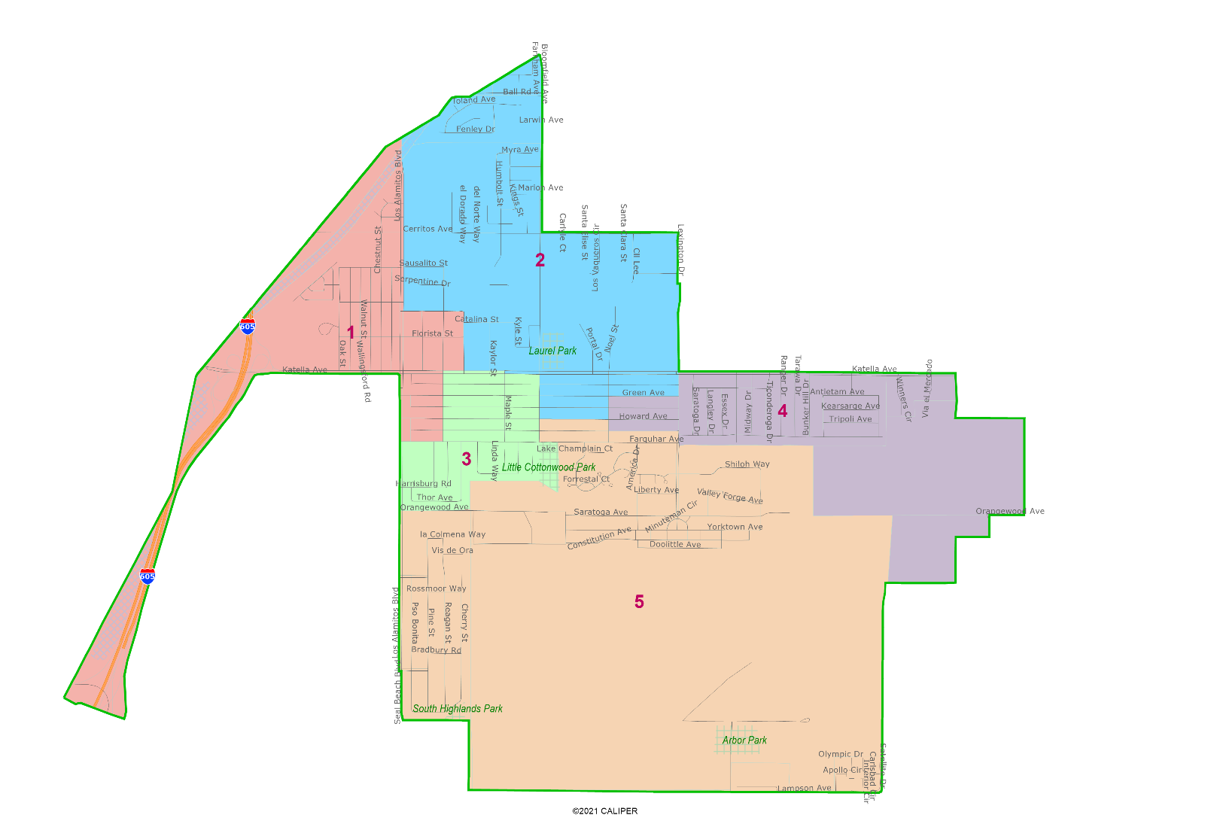
City of Los Alamitos Draft Plan Presentation
Dr. Justin Levitt, Vice President
National Demographics Corporation

Slide 2
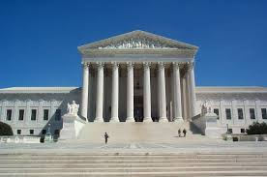
Redistricting Rules and Goals
1. Federal Laws
2. California Criteria for Cities
3. Other Traditional Redistricting Principles
Equal Population
Federal Voting Rights Act
No Racial Gerrymandering
Geographically contiguous
Undivided neighborhoods and “communities of interest” (Socio-economic geographic areas that should be kept together)
Easily identifiable boundaries
Compact (Do not bypass one group of people to get to a more distant group of people)
Prohibited: “Shall not favor or discriminate against a political party.”
Minimize voters shifted to different election years
Respect voters’ choices / continuity in office
Future population growth
Preserving the core of existing districts

Slide 3
Draft Maps
All maps are also available on the Interactive Web Viewer

Slide 4
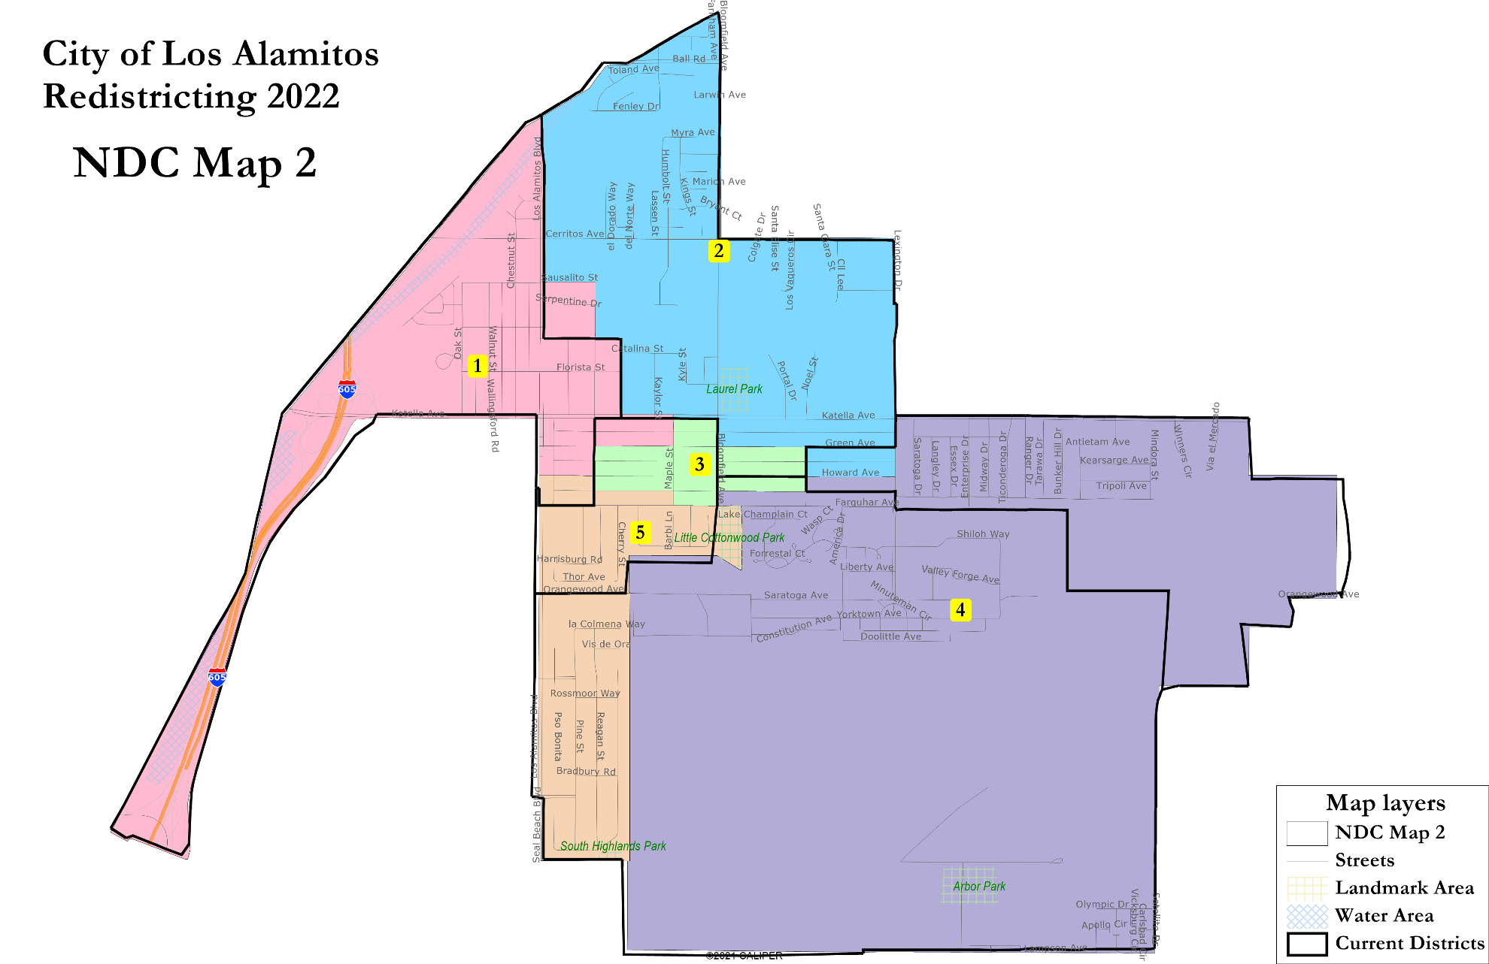
NDC Map 2

Slide 5
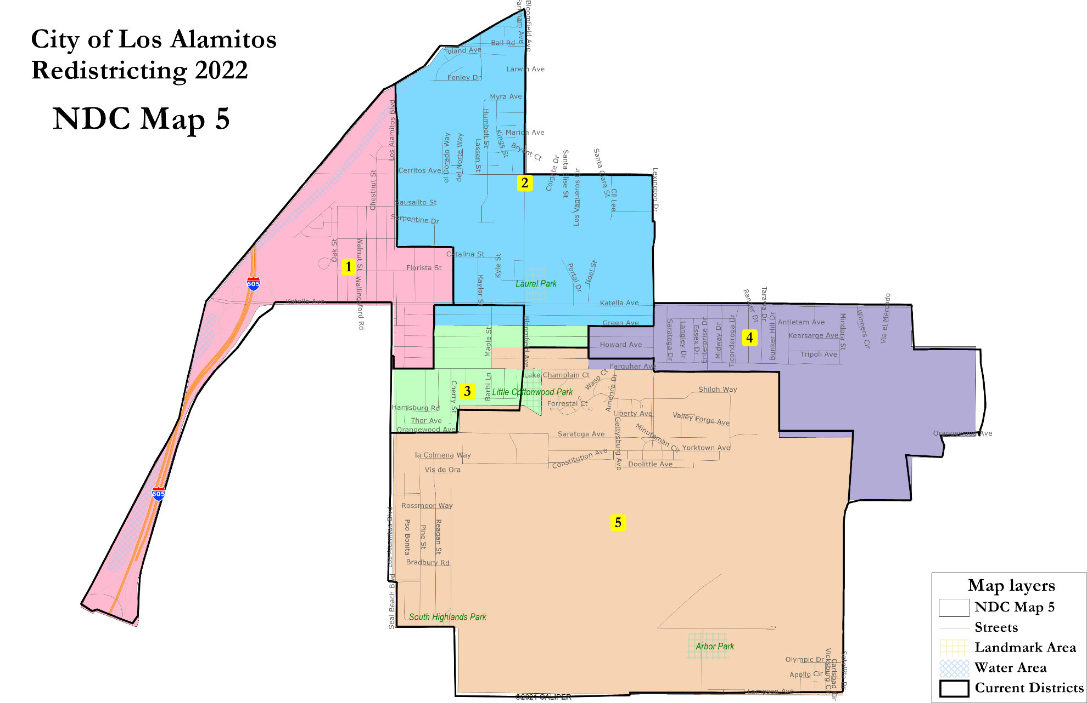
NDC Map 5

Slide 6
Public Hearing & Discussion
How well do the draft maps comply with the Fair Maps Act?
Which map best serves the city of Los Alamitos for the next decade?
Council may select a map and/or provide additional direction to staff and the demographer

